Slide 1
CEE432/CEE532/MAE541
Developing Software for Engineering Applications
Lecture 3: Control Structures
(Chapter 3)
© 1998-2012, S. D. Rajan

Slide 2
Selection with if
Syntax
Form 1
if (expression)
statement(s) if expression is true;
Form 2
if (expression)
statement(s) if expression is true;
else
statements(s) if expression is false;
© 1998-2012, S. D. Rajan

Slide 3
Selection with if
Form 3
if (expression1)
statement(s) if expression1 is true;
else if (expression2)
statements(s) if expression2 is true;
…
else
statements(s);
Form 4
if (expression1)
statement(s) if expression1 is true;
else if (expression2)
statements(s) if expression2 is true;
else if (expression3)
statements(s) if expression3 is true;
© 1998-2012, S. D. Rajan

Slide 4
Relational Operators
< less than
<= less than or equal to
> greater than
>= greater than or equal to
!= not equal to
== equal to
© 1998-2012, S. D. Rajan

Slide 5
Logical Operators
|| or
&& and
Usage
if (expression1 || expression2) …
if (expression1 && expression2) …
Beware
| is not the same as ||
& is not the same as &&
© 1998-2012, S. D. Rajan

Slide 6
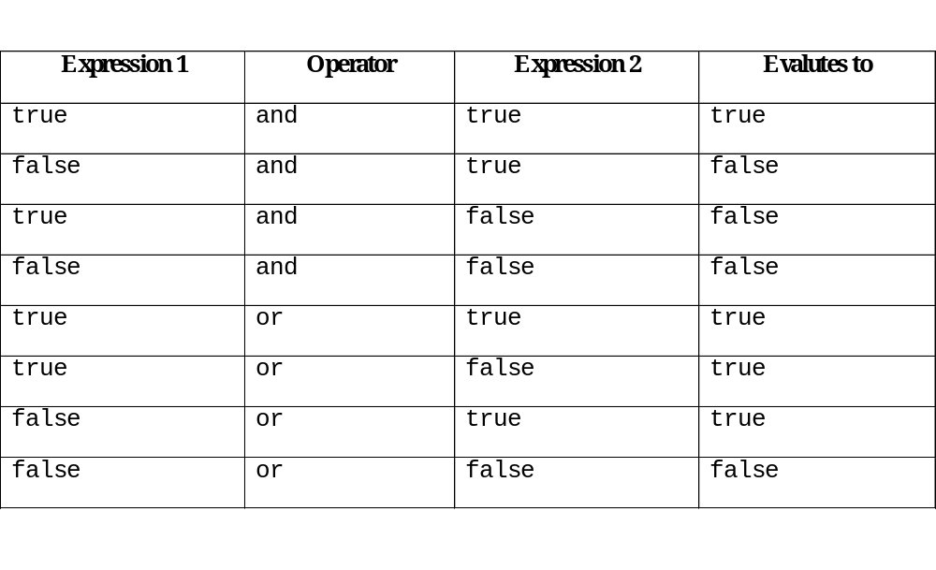
Logical Operators
© 1998-2012, S. D. Rajan

Slide 7
Example Expressions
Example 3.1.1
© 1998-2012, S. D. Rajan

Slide 8
Nested if statement
Beware, use { …} to ensure correctness
if (expression)
{
if (expression)
{
…
}
}
© 1998-2012, S. D. Rajan

Slide 9
Nested if statement
float fX = 4.15f, fY = 2.14f;
….
// not written correctly
if (fX <= fY)
if (fX < sqrt(20.0))
cout << “X is < square root of 20.”;
else
cout << “X is greater than Y.”;
© 1998-2012, S. D. Rajan

Slide 10
Conditional operator ?:
Syntax
variable = (logical expression ? expression1 : expression2);
If logical expression is true then variable value is set to expression1 otherwise expression2.
© 1998-2012, S. D. Rajan

Slide 11
Conditional operator ?:
If weight of the person is greater than 400 lb then person is obese.
bool bObese; float fWeight;
bObese = (fWeight > 400.0f? true : false);
if (fWeight > 400.0f)
bObese = true;
else
bObese = false;
© 1998-2012, S. D. Rajan

Slide 12
Repetition with while
Syntax
while (test condition)
{
…
}
© 1998-2012, S. D. Rajan

Slide 13
Repetition with while
Example 3.2.1
© 1998-2012, S. D. Rajan

Slide 14
Repetition with do … while
Syntax
do
{
….
} while (test condition);
© 1998-2012, S. D. Rajan

Slide 15
Repetition with do … while
Example 3.2.2
© 1998-2012, S. D. Rajan

Slide 16
Increment and Decrement Operators
++ increment operator
-- decrement operator
Increase or decrease the value by one when the operand is an integer or a real number. Can be used as a prefix or a postfix operator.
© 1998-2012, S. D. Rajan

Slide 17
Increment and Decrement Operators
int i = 10;
j = (++i) + 3;
int i = 10;
j = (i++) + 3;
© 1998-2012, S. D. Rajan

Slide 18
Comma , operator
The operator is used to separate a list of expressions and returns the value of the last expression that is evaluated.
nSum = (nX = 2, nY = nX + 3);
© 1998-2012, S. D. Rajan

Slide 19
Repetition with for
Syntax
for (initialization; test condition; change in loop index)
{
….
}
© 1998-2012, S. D. Rajan

Slide 20
Repetition with for
initialization section has loop indexing variable
test condition is always checked before the first statement in the loop is executed
change in loop index is an expression or assignment that is executed after the last statement in the loop
© 1998-2012, S. D. Rajan

Slide 21
Repetition with for
Example 3.2.3
© 1998-2012, S. D. Rajan

Slide 22
Nested for Loops
int nCount = 0;
for (i=1; i <= n; i++)
{
for (j=1; j <= m; j++)
{
nCount++;
}
}
cout << “Value of nCount is : “
<< nCount << “\n”;
© 1998-2012, S. D. Rajan

Slide 23
Other Control Structures
break
Placing this statement at an appropriate location ensures that the control (or program flow) is immediately shifted to outside the innermost loop that the break statement is associated with.
© 1998-2012, S. D. Rajan

Slide 24
Other Control Structures
continue
Placing this statement at an appropriate location ensures that the statements between the continue statement and the end of the nearest loop are not executed.
© 1998-2012, S. D. Rajan

Slide 25
Other Control Structures
switch
switch (integral expression)
{
case ConstantExpression1:
statement(s)
break;
case ConstantExpression2:
statement(s)
break;
…
default:
statement(s)
break;
}
© 1998-2012, S. D. Rajan

Slide 26
Other Control Structures
goto
goto label;
…
label: statement(s);
© 1998-2012, S. D. Rajan

Slide 27
Using STL string class
#include <string>
std::string szName;
szName = “John Doe”;
or
std::string szName (“John Doe”);
© 1998-2012, S. D. Rajan

Slide 28
enumerated Type
Syntax
enum enumeration_type {list of integer constants};
Example
enum StudentTypes {FRESHMEN, SOPHOMORE, JUNIOR, SENIOR);
StudentTypes StudentinCEE321;
….
StudentinCEE321 = JUNIOR;
© 1998-2012, S. D. Rajan

Slide 29
Type coercion
Mixed type arithmetic (promotion and demotion)
fSemGPA += static_cast<float>(4*nCourseSemHrs);
Syntax
variable = static_cast<datatype of variable> (expression);
© 1998-2012, S. D. Rajan

Slide 30
Type Coercion
Step 1: Each char, short, bool, or enumeration value is promoted to int. If both operands are now int, the result is an int expression.
Step 2: If Step 1 still leaves a mixed type expression, the following precedence of types is used:
Lowest → highest
int, unsigned int, long, unsigned long, float, double, long double
The value of the operand of the lower type is promoted to that of the higher type, and the result is an expression of that type.
© 1998-2012, S. D. Rajan

Slide 31
Type Coercion
int nI = 'c' + 1;
double dX = (nI + 4.0);
// promotion
double dX =
static_cast<double>(nI + 4.0);
// demotion
float fX =
static_cast<float>(pow(2.5,3.5));
© 1998-2012, S. D. Rajan

Slide 32
Output Formatting
Need control over
  floating point precision
  type of floating point representation
  output width
  whether to show the + and – signs
  whether to show the . and trailing zeros in floating point numbers
  placement of output (justification)
© 1998-2012, S. D. Rajan

Slide 33
Summary
C++ provides a variety of control structures
  if else
  do
  do .. while
  for
  ?:
  break
  continue
  switch
  goto
© 1998-2012, S. D. Rajan

Slide 34
Summary
We also learnt about
  type coercion
  STL string class (a lot more to come)
  A brief introduction to format controls
© 1998-2012, S. D. Rajan

